Slide 1
Data Analytics
Analytic Tools
Analysis Vs Reporting
Modern DA Tools
S.V.Jansi Rani
Assistant Professor / CSE
Notes:
The University of Adelaide, School of Computer Science
Chapter 2 — Instructions: Language of the Computer

Slide 2
Outline
Analytic Tools
Analysis Vs Reporting
Modern DA Tools

Slide 3
Analytic Tools
The Rise of Graphical User interfaces:
The graphical user interface (GUI ), is a type of user interface that allows users to
interact with electronic devices through graphical icons and visual indicators.
Benefits:
  It will be bug free & optimized.
  Able to review the code.

Slide 4
The Explosion of point solutions:
Analytic point solutions are software packages that address a very specific narrow set of problems.
Example :
Price optimization application.
Fraud applications
Demand forecasting applications
Drawbacks :
Quite expensive.

Slide 5
The History of open source:
  Open source packages are available to the public for free via download
  The actual source code is available so that users can customize and add on to the software as desired
Example:
  Firefox – web browser
  Linux – OS
  Apache - web server
  There are open source databases, open source business intelligence & reporting

Slide 6
tools, open source data integration tools, open source office productivity suites etc.
Features:
Thousands of individuals are contributing to improving the functionality of that tool.
If a bug is found, it can be patched quickly.

Slide 7
The R project for statistical computing
R is a free software environment for statistical computing and graphics. It
compiles and runs on a wide variety of UNIX platforms, Windows and MacOS.
R is an implementation of the S programming language.
Downside:
Fairly intensive process.
Scalability
The history of data visualization

Slide 8
The history of data visualization
Visualization refers to charts, graphs and tables that display data.
Modern visualization tools
Today’s visualization tools allow multiple tabs of graphs and charts to be linked to
the underlying data.

Slide 9
Outline
Analytic Tools
Analysis Vs Reporting
Modern DA Tools

Slide 10
ANALYSIS VS REPORTING
Reporting:
The process of organizing data into informational summaries in order to monitor
how different areas of a business are performing
Analysis:
The process of exploring data and reports in order to extract meaningful insights,
which can be used to better understand and improve business performance.
Purpose
Reporting translates raw data into information.
Analysis transforms data and information into insights.

Slide 11
Reporting helps companies to monitor their online business and be alerted to when data falls outside of expected ranges.
Good reporting should raise questions about the business from its end users.
The goal of analysis is to answer questions by interpreting the data at a deeper level and providing actionable recommendations.

Slide 12
Tasks
Analysis focuses on questioning, examining, interpreting, comparing, and confirming.
Reporting and analysis tasks can be intertwined, but analysts should still evaluate where they are spending the majority of their time.
Outputs
On the surface, reporting and analysis deliverables may look similar with lots of charts, graphs, trend lines, tables, and stats.

Slide 13
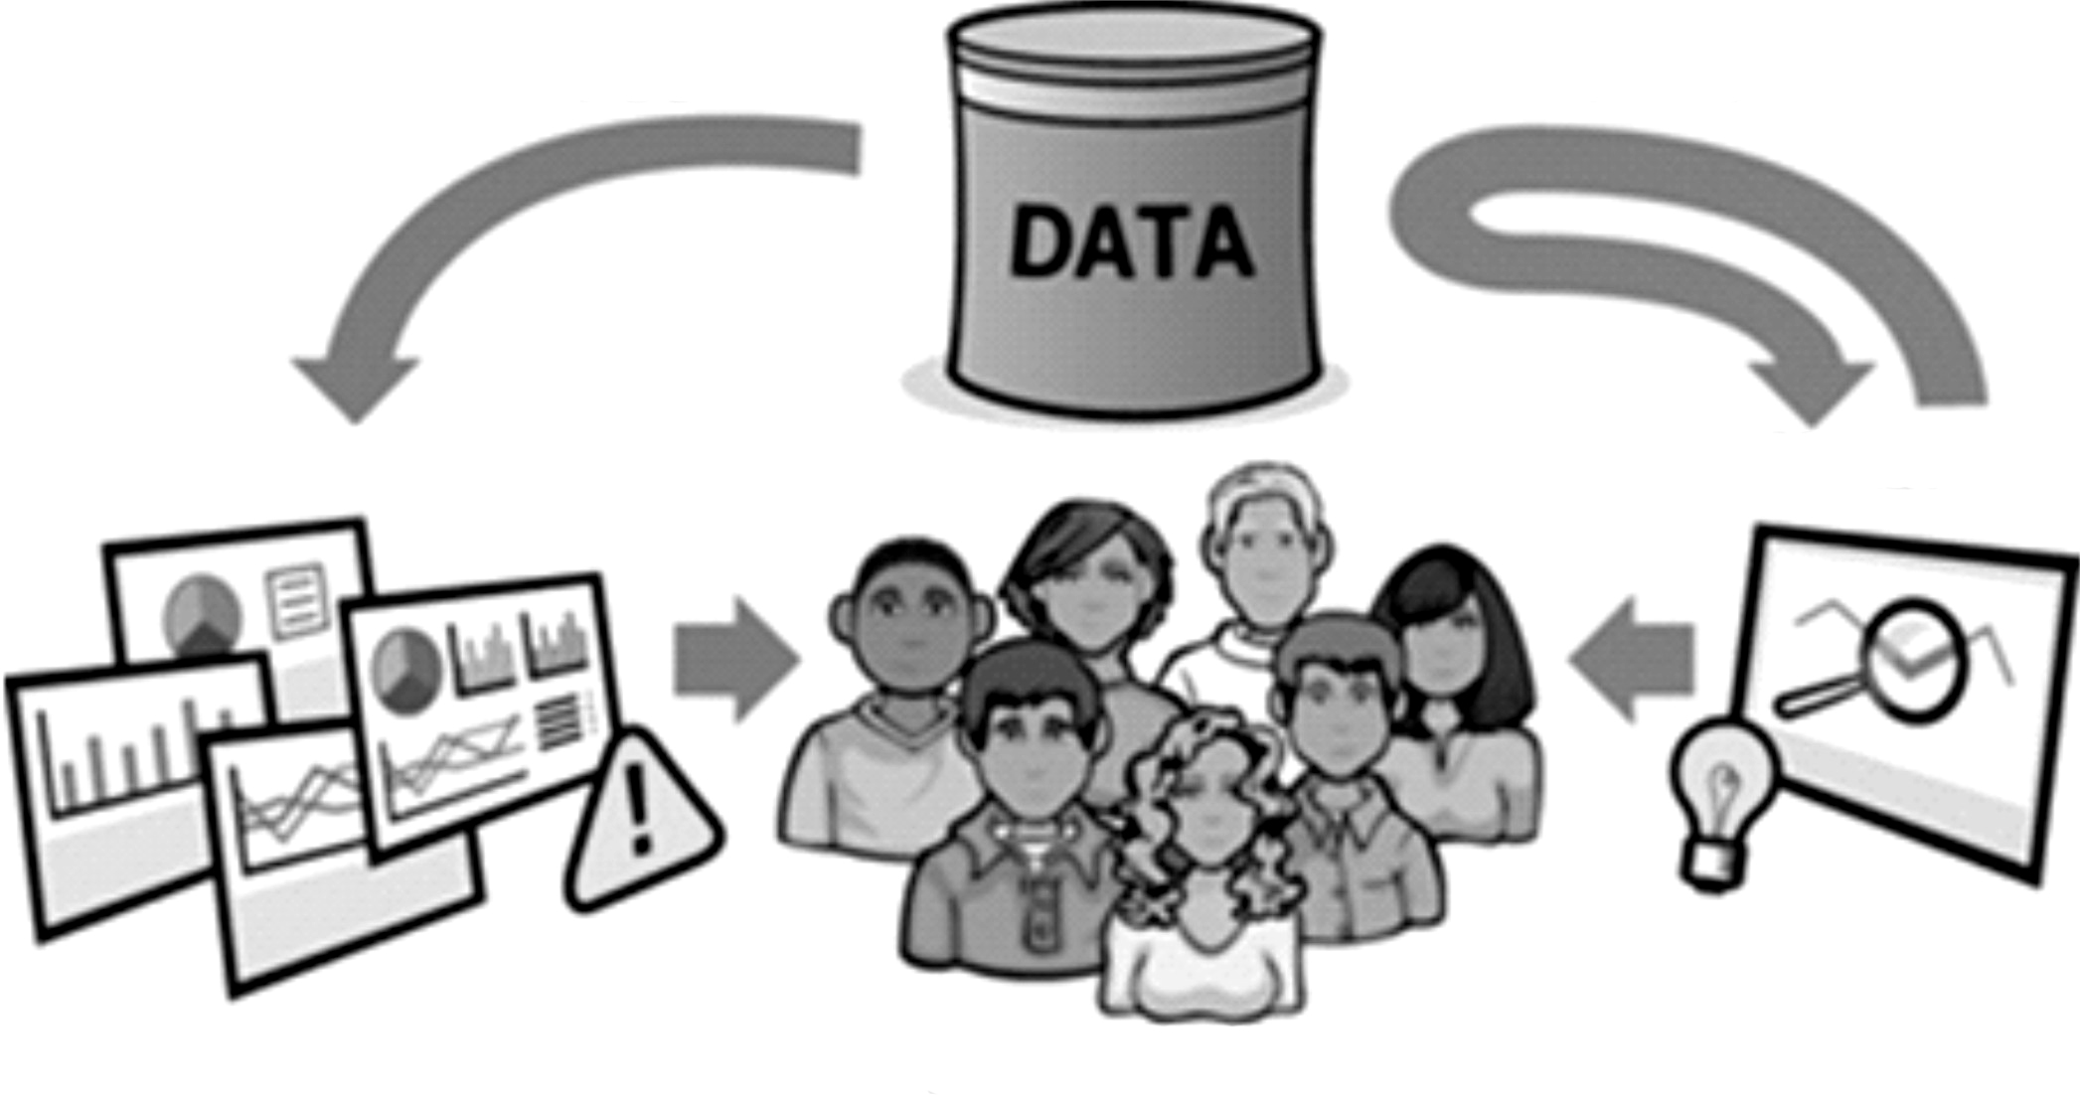
Reporting pushes information and analysis pulls insights

Slide 14
Reporting generally follows a push approach, where reports are passively pushed to users who are then expected to extract meaningful insights and take appropriate actions for themselves.

Slide 15
Three types of reports
Canned reports
These are the out-of-the-box and custom reports that we can access within the
analytics tool or which can also be delivered on a recurring basis to a group of end users.
Canned reports are fairly static with fixed metrics and dimensions.

Slide 16
Dashboards
These custom-made reports combine different KPIs and reports to provide a
comprehensive, high-level view of business performance for specific audiences.
Dashboards may include data from various data sources and are also usually fairly static.
Alerts
These conditional reports are triggered when data falls outside of expected ranges
or some other predefined criteria are met. Once people are notified of what happened,
they can take appropriate action as necessary.
In the case of analysis with actual deliverables, there are two main types: main types of reporting are

Slide 17
Ad hoc responses
Analysts receive requests to answer a variety of business questions, which may be
spurred by questions the reporting raised. Typically, these urgent requests are time sensitive
and demand a quick turnaround. The analytics team may have to juggle multiple requests
at the same time.

Slide 18
Analysis presentations
Some business questions are more complex in nature and require more time to
perform a comprehensive, deep-dive analysis. These analysis projects result in a more
formal deliverable, which includes two important sections: key findings and recommendations.

Slide 19
Delivery
Through the push model of reporting, recipients can access reports through an analytics tool, intranet site, Microsoft Excel, spreadsheet, or mobile app.
They can also have them scheduled for delivery into their mailbox, mobile device (SMS), or FTP site.
On the other hand, analysis is all about human beings using their superior
reasoning and analytical skills to extract key insights from the data and form
actionable recommendations for their organizations.

Slide 20
Value
We need to keep in mind the relationship between reporting and analysis in
driving value.
Think of the data-driven decision-making stages (data > reporting > analysis >decision > action > value) as a series of dominoes.
If we remove a domino, it can be more difficult or impossible to achieve the desired value.

Slide 21
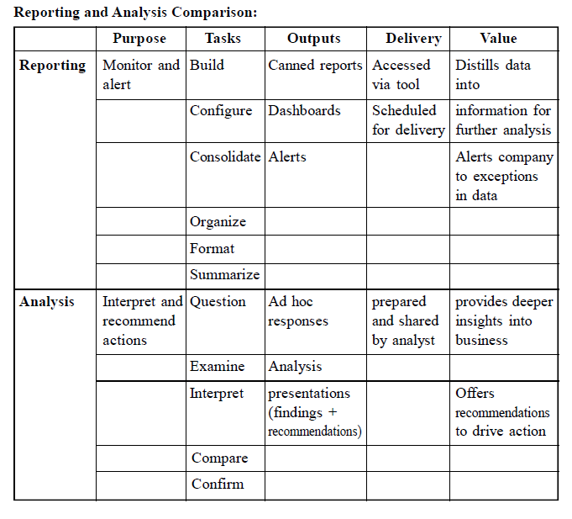

Slide 22
Outline
Analytic Tools
Analysis Vs Reporting
Modern DA Tools

Slide 23
MODERN DATA ANALYTIC TOOLS
1. DB Miner:
It is a new generation of business intelligence & performance management
applications powered by data mining.
2. Data engine:
A software tool for intelligent data analysis, combining conventional data analysis
methods with fuzzy technologies, neural networks, decision trees & statistical methods.
3. Knowledge Miner
It is an artificial intelligence tool designed to easily extract hidden knowledge from
data.

Slide 24
4. Tableau Public:
Tableau democratizes visualization in an elegantly simple and intuitive tool. It is
exceptionally powerful in business because it communicates insights through data
visualization.
5. OpenRefine:
Formerly GoogleRefine, OpenRefine is a data cleaning software that allows you to
get everything ready for analysis.

Slide 25
6. KNIME:
KNIME allows you to manipulate, analyze, and modeling data in an incredibly
intuitive way through visual programming
7. RapidMiner:
Much like KNIME, RapidMiner operates through visual programming and is capable
of manipulating, analyzing and modeling data.

Slide 26
8. Google Fusion Tables:
Google Fusion tables are an incredible tool for data analysis, large data-set
visualization, and mapping. Google’s incredible mapping software plays a big role in
pushing this tool onto the list With just a quick upload, Google Fusion tables recognized
the latitude and longitude data and got to work.
9. NodeXL:
NodeXL is visualization and analysis software of networks and relationships.

Slide 27
10. Google Search Operators:
Google is an undeniably powerful resource and search operators just take it a step up.
The operators can be even more useful for discovering new information or market research.
11. Solver:
Solver is an optimization and linear programming tool in excel that allows you to
set constraints. Solver will make quick work of a wide range of problems.

Slide 28
12. WolframAlpha:
Wolfram Alpha’s search engine is one of the web’s hidden gems and helps to power
Apple’s Siri. For business users, it presents information charts and graphs, and is excellent
for high level pricing history, commodity information, and topic overviews.

Slide 29
Thank You

